Slide 1
Robust Euro Notes Classification
€€€
(Adversarial Attack-Defense)
Johannes Heidecke
Denys Kovalenko
Alberto Olivares Alarcos
Alejandro Suárez Hernández
Notes:
Hi! Some of you might not be surprised that today we will talk about money. And how not to loose them, with the help of robust machine learning.

Slide 2
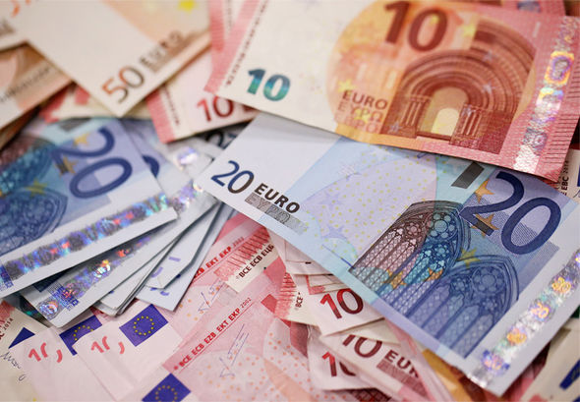
Notes:
Main objective of our project is to build robust intelligent system that counts money, by classifying images of euro banknotes, even when exposed to adversarial attacks. Making good classifier is not enough today, it has to defend itself from malicious agents that try to manipulate with data.

Slide 3


First - get hands dirty
Scan QR code
OR
2. Visit wickedconbusters.com
Notes:
First, to get the feeling of what we are doing we are asking you to take out your phones and try our service yourself. Scan QR code or follow provided link. Take a picture of euro bill and upload it there. I’m gonna do the same on a laptop.
// use prepared picture and try classifier. Explain what happens on vanilla example.

Slide 4

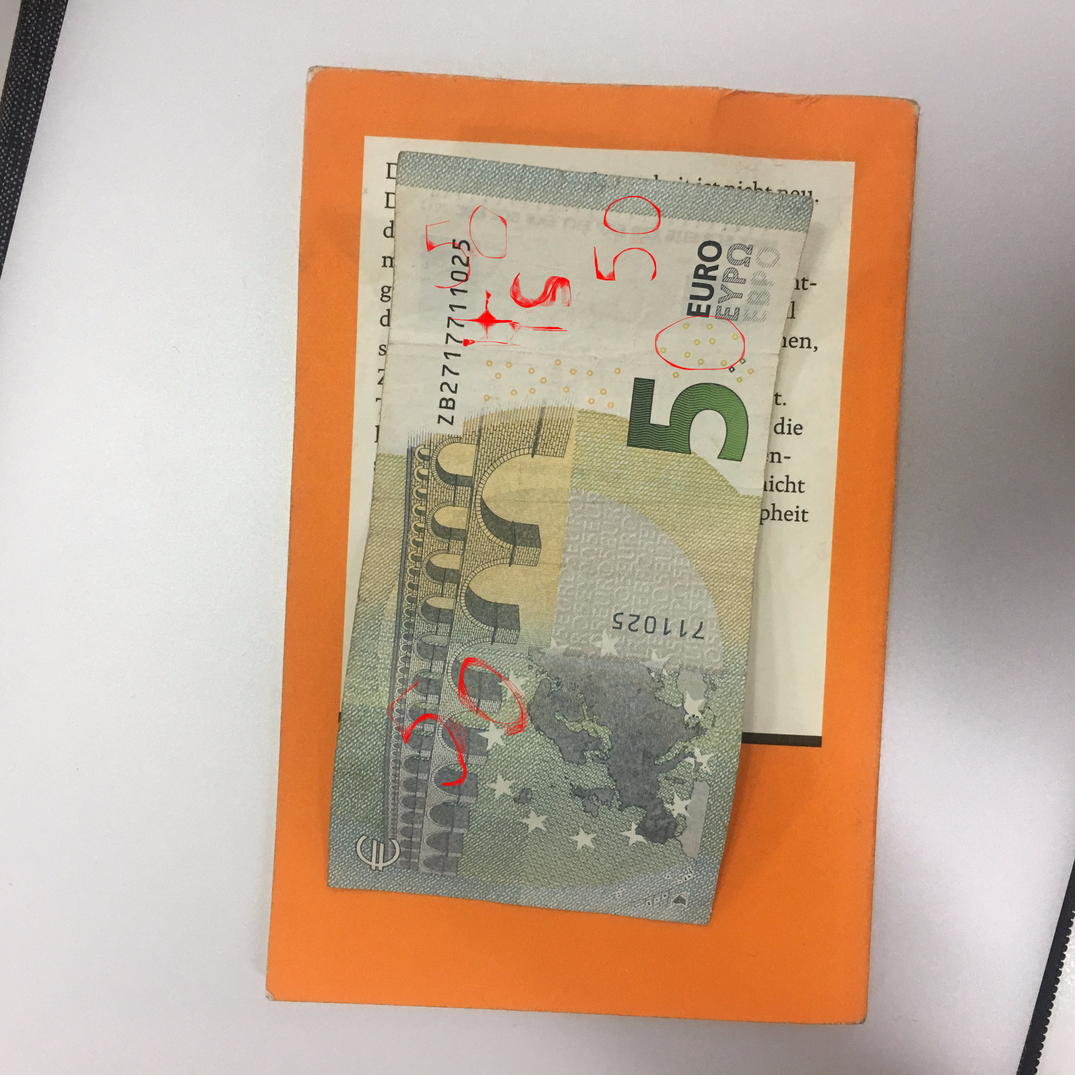
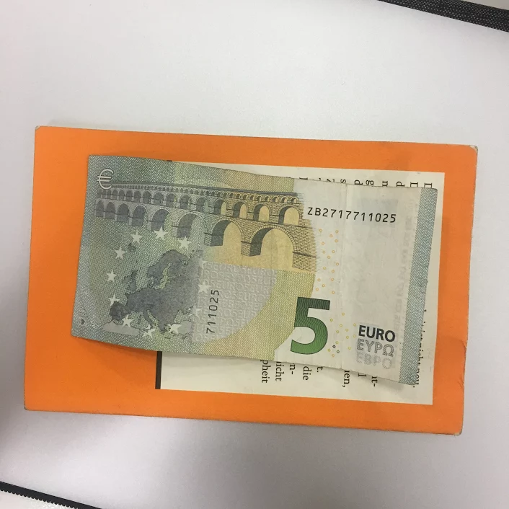
Adversarial attack
5€
50€
5 eur photo here
Notes:
So, what are those attacks? From what are we trying to defend classifier?
Lets imagine that some Bob wants to pay less for Chupa-Chups in a shop of Alice, that has automatic cash desk. He draws Zero next to 5 on 5-euro bill, and that’s enough for the classifier to think it’s 50! (Click on slide). He then receives Chupa-Chups and even gets 49 euros of change. (No real money was damaged during generation of this adversarial example)
Some of the attacks of course are less obvious to human eye and can just be done by editing few pixels, or changing color hue, or adding noise.

Slide 5
More examples
Courtesy - blog.openai.com

Slide 6
Why Does This Happen?
Classifier has seen too “pure” examples and have extracted not robust features, for instance - “recognize any number on the picture and define class based on it”
Notes:
Why this happens? When training data is too “pure”, classifier becomes “naive” and can be easily fooled.
Today, with self-driving cars and AI claiming to get into any part of our lives, it’s essential to make machine learning models robust to such attacks and to have them be at least as robust to such attacks as humans experts (though, not perfect themselves) are.

Slide 7
How to solve it?
Start thinking as an attacker ourselves
Generate adversarial examples
Defend (train) classifier against these examples
Go to step 1, repeat until accuracy doesn't degrade on adv. examples
Notes:
As in computer security in general, to be able to defend from attack, you must know how to attack. So this is rough plan:
Start thinking as an attacker ourselves
Generate adversarial examples
Defend (train) classifier against these examples
Go to step 1, repeat until accuracy doesn't degrade on adv. Examples
That’s how classifiers becomes aware of that banknote can be not perfect, and still classify them correctly.

Slide 8
Problem specification
System receives banknote image (5, 10, 20, 50 euros only)
Image must have only 1 banknote
System classifies it into 4 categories
System is exposed to adversarial attacks
System must maintain high accuracy even on modified images
Notes:
//This is kinda boring.
Our system receives images of banknotes, one by one. On each image there is only one banknote (it’s not possible to have empty image, or have 2 or more banknotes in same image).
We permit only euro banknotes of 5,10,20,50 nomination.
On some stage image of banknote or banknote itself can be altered by attacker, so we must be able to maintain high accuracy despite that

Slide 9
Limitations:
All of the images are real banknotes (no counterfeit money available to us)
We don't classify 100, 200 and 500 euros bills
We have only euro banknotes in the dataset
Notes:
As it’s hard to legally obtain conterfeit money, we don’t try to solve problem of detecting fake money - we assume that all images contain real money.

Slide 10
Objectives
Collect data
Train strong classifier for “normal” data
Implement state-of-the-art attacks (GAN, PGD)
Implement defense mechanism
Give analysis of strengths and weaknesses of the implemented system

Slide 11
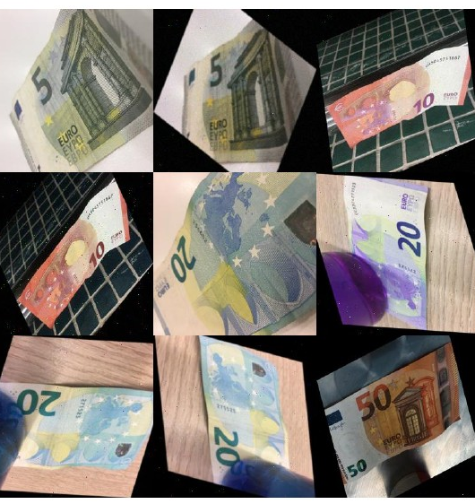
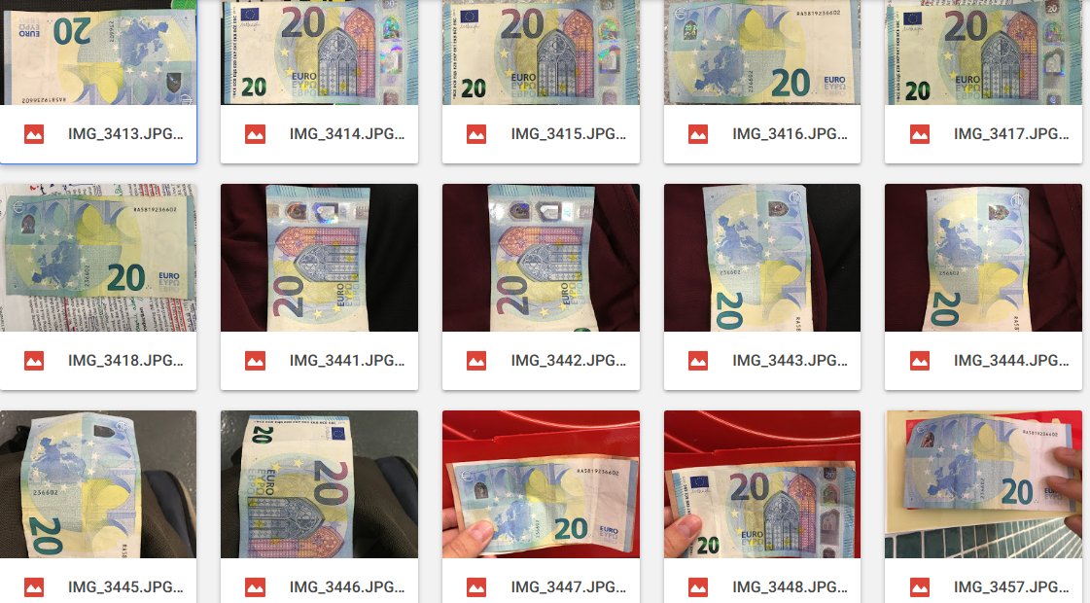
Notes:
Just wanted to show you data collection - one of the most important parts of machine learning pipeline

Slide 12

Let’s go Deep!
Lets go deep!

Slide 13
Training Classifier
CNN - Pre-trained ResNet with 18 layers (by Torchvision)
Pytorch for model training
4 target classes
470 original images, 47000 augmented. 224 x 224 pixels
100 epochs
99.43% accuracy! But...

Slide 14
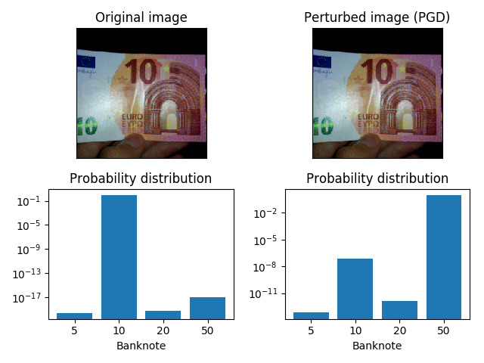
Results
Notes:
Running a bit forward - Almost perfect classifier turns out to be very easy to break after attack was implemented. How have we managed to trick classifier?

Slide 15
PGD - projected gradient descend
Strongest among implemented
White box
Direct and transerred attacks

Slide 16
GAN - Generative Adversarial Networks
Attacker is trained on loss of classifier;
Black box

Slide 17
Hardware requirements
Computer with powerful GPU for training ( g3.8xlarge on AWS)
Camera, capable of making pictures with 640*640 pixels quality
For running system - regular servers, depends on images/second
Notes:
We m

Slide 18
Human resources needed:
• System analysis and design: 2 persons skilled in ML, Software Architecture * 3 weeks
• System implementation: 2 skilled people * 3 weeks
• Dataset generation: Manual data generation; Unskilled person * 1 week

Slide 19
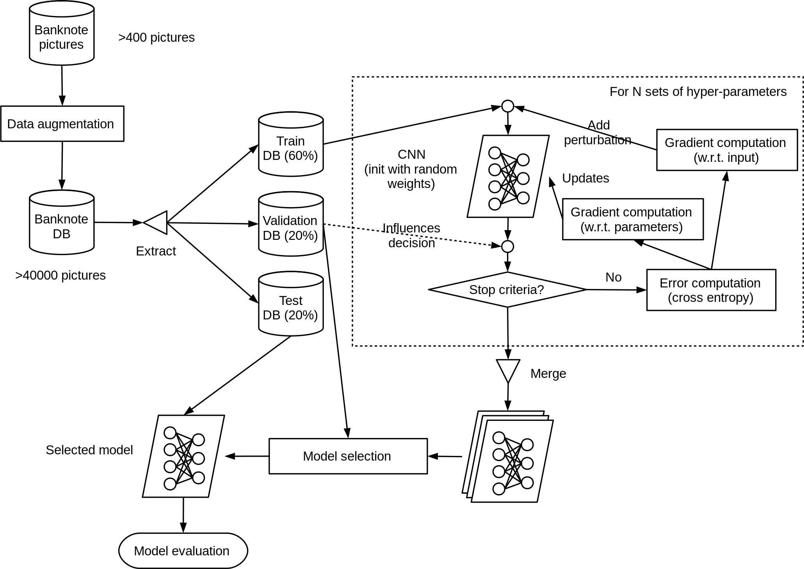

Slide 20
Protection against adversarial attacks
Following pipeline is required:
Train base classifier
Implement attacks
Implement a defence strategy

Slide 21
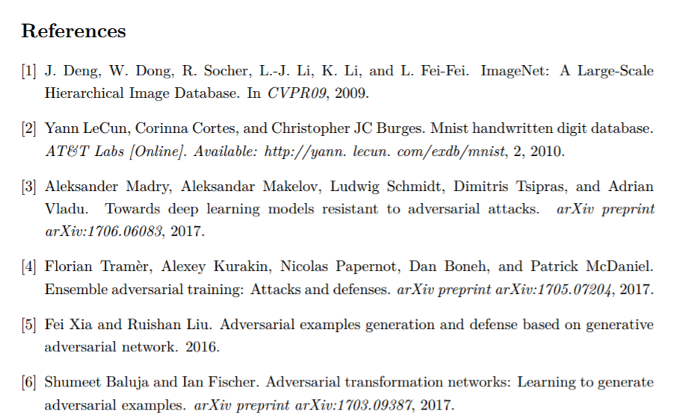
Methods and alternatives
https://github.com/sprkrd/UPC-MAI-ISP
http://tinyurl.com/isp-summaries
Notes:
Research of literature gave us several options regarding attack and defence.
We have compiled accumulated knowledge by writing summaries, that give overview to state-of-art technics.
Also, code for our classifier is available on Github

Slide 22
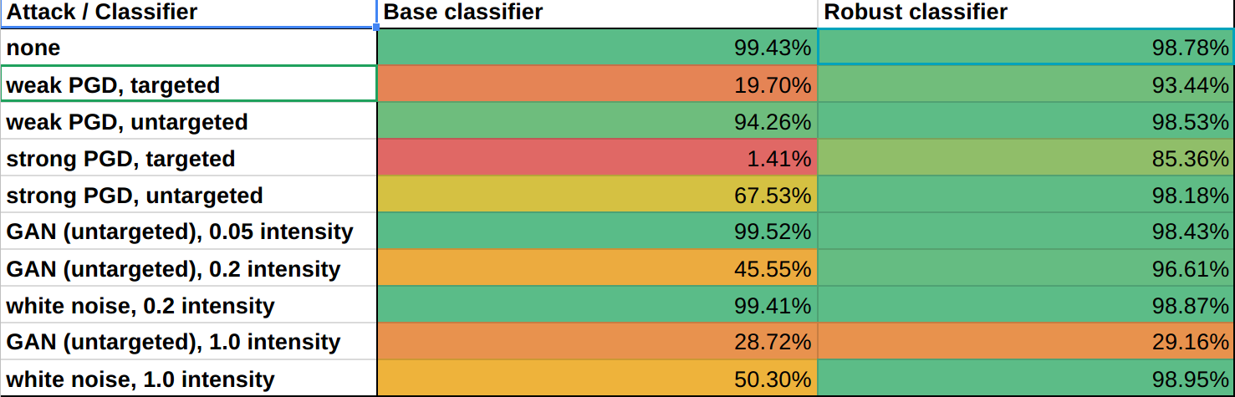
Robustness delivered
Notes:
Our approach allowed to retain production level quality under most vectors of attack

Slide 23
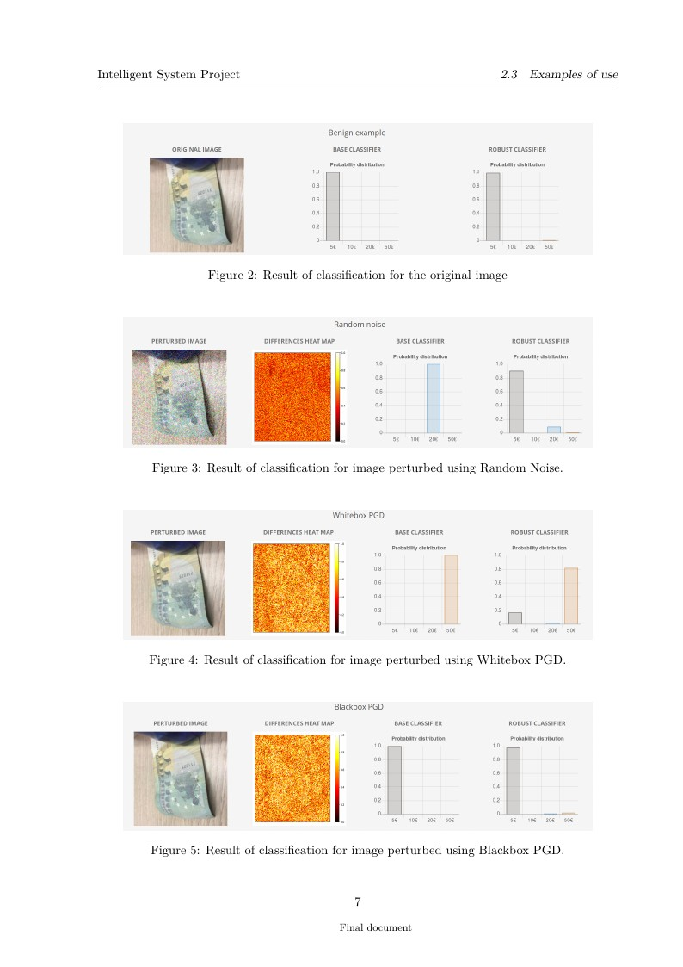
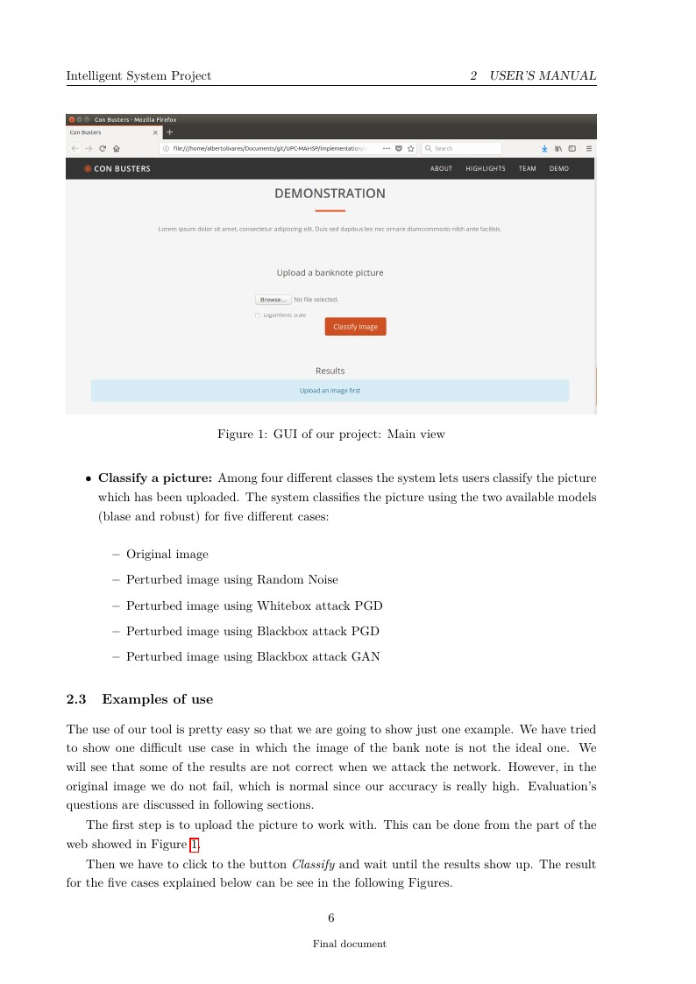
Prototype Ready

Slide 24
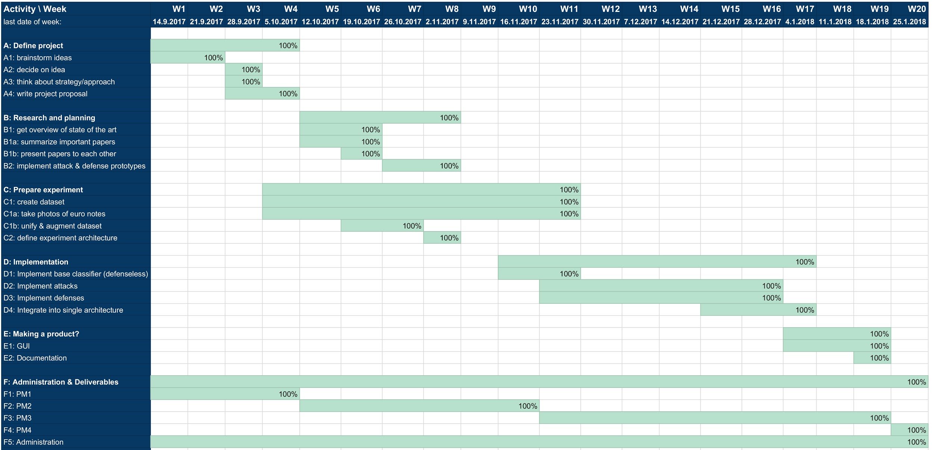
Overachievement achieved
Euro bills dataset collected
10,000 training images generated
Classifier prototype is trained, working on accuracy
Adversarial attacks and defence strategies studied and analysed
Notes:
Up to this moment, we have
1)gathered dataset of euro banknotes (took pictures of own money);
2) Performed data augmentation (automatically generate similar images, applying noize, rotation, manipulation of colour)
3)Studied and discussed state-of-art attack and defence meachanisms against adversarial attacks
4) Trained classifier with reasonable performance
As it can be seen from Gant diagram, we are even a bit ahead of the schedule.

Slide 25
Conclusions:
Strong classifier for euro bank notes trained
State-of-art attacks implemented
Classifier successfully defended from attacks
User-friendly prototype ready
…. Success!

Slide 26


